Slide 1
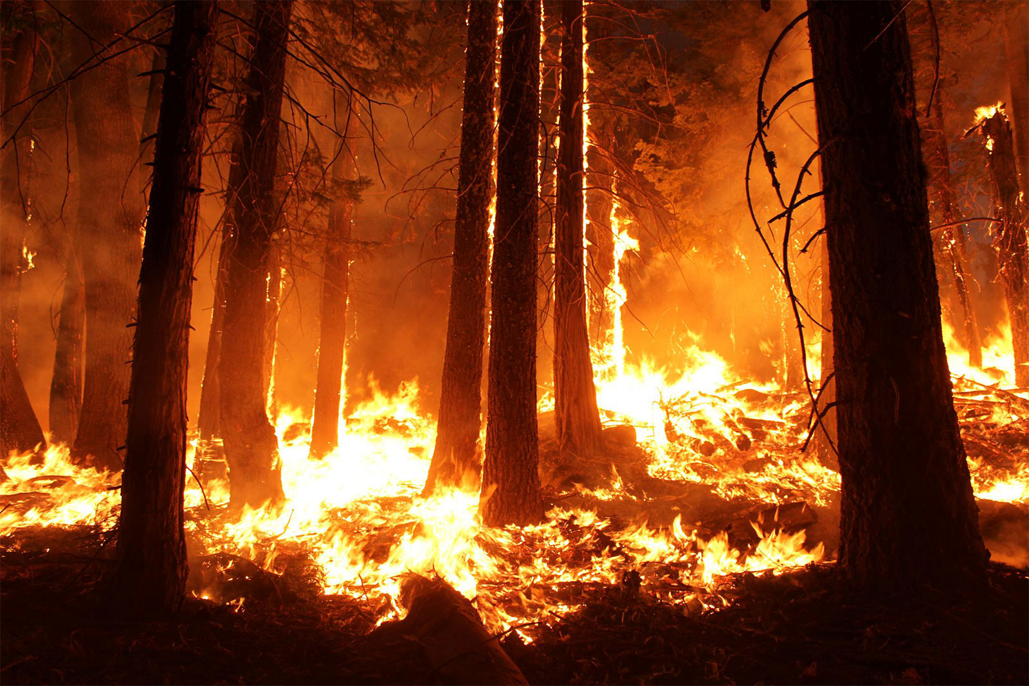
California Wildfire Analysis and prediction
Hareesh Nair
Regis University
Fig 1

Slide 2
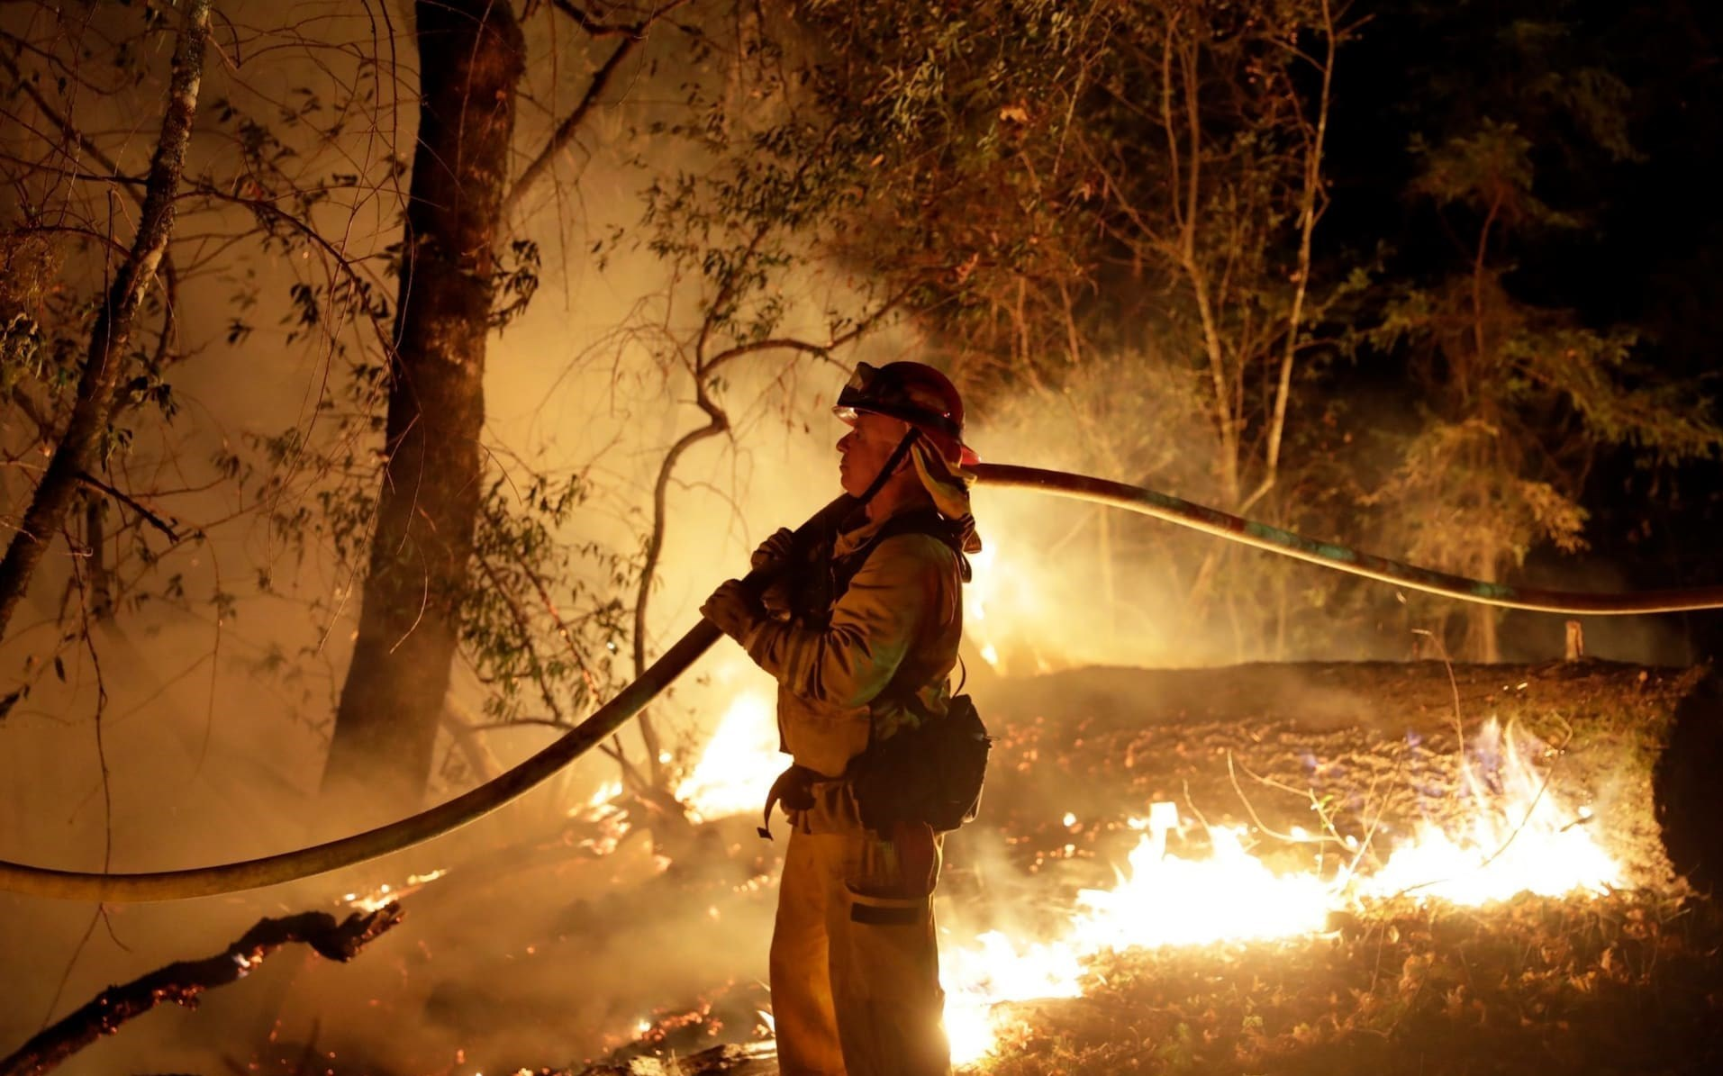
Introduction
Wildfire is increasing a lot in California
weather is one of the major challenges.
Human ignited fires is also common.
Electrical Accidents also very common.
Arson is a major unavoidable factor.
This Photo by Unknown Author is licensed under CC BY

Slide 3
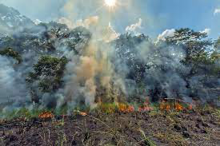
Problem statement
Analyze the various factors of Fire incidents occurred in California.
Prediction of fire using the weather data.

Slide 4
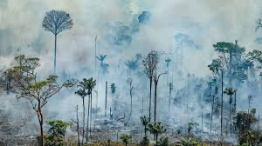
Data set used
California wildfire data set
California Weather data

Slide 5
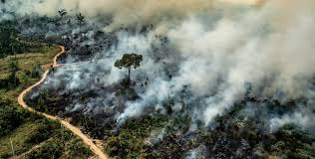
Data Preparation
Handled null values
Dropped unwanted columns.
Conversion of some data set to join proper merged data.

Slide 6
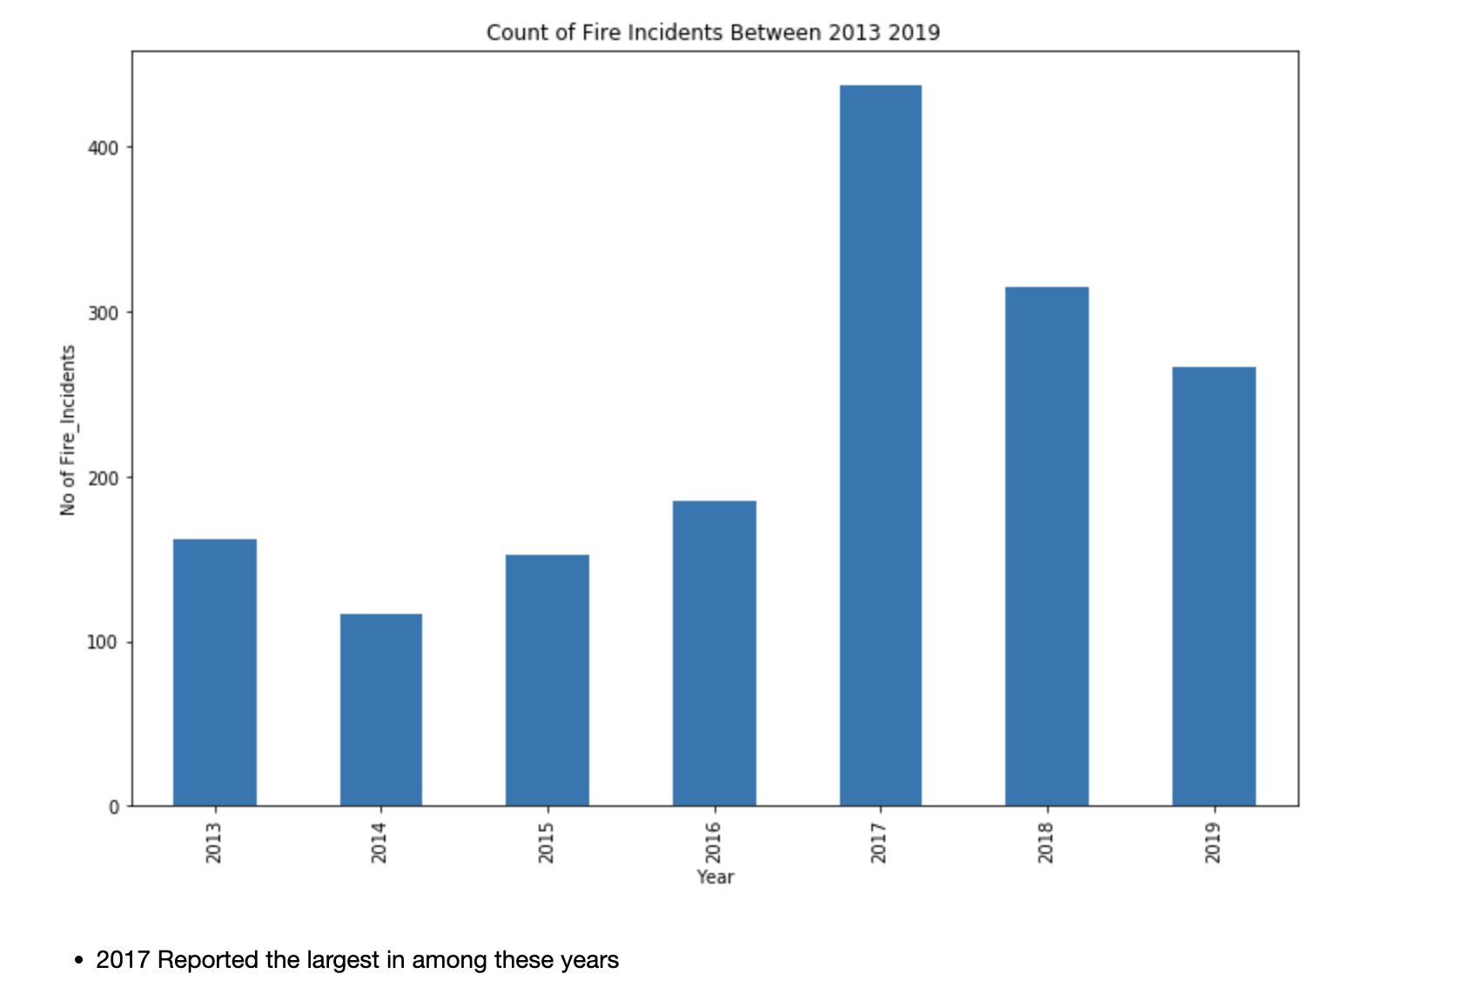
Data Visualization
From Reports and datasets 2017 received the largest number of wildfire in these years.

Slide 7
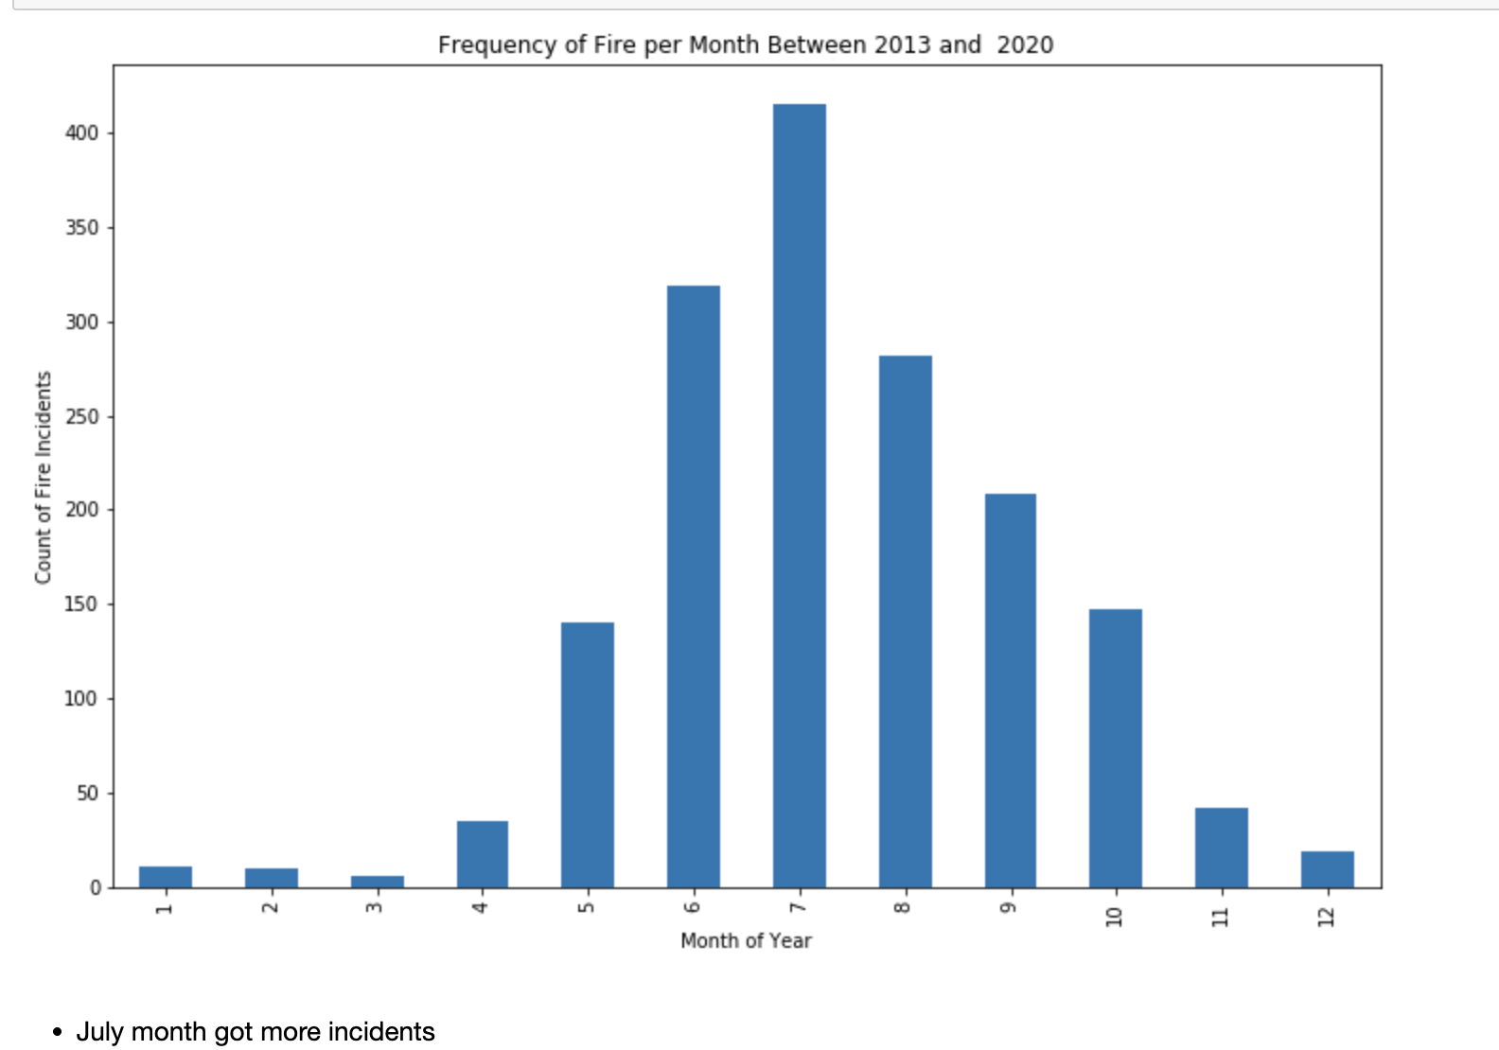
Data Visualization
July received more incidents

Slide 8
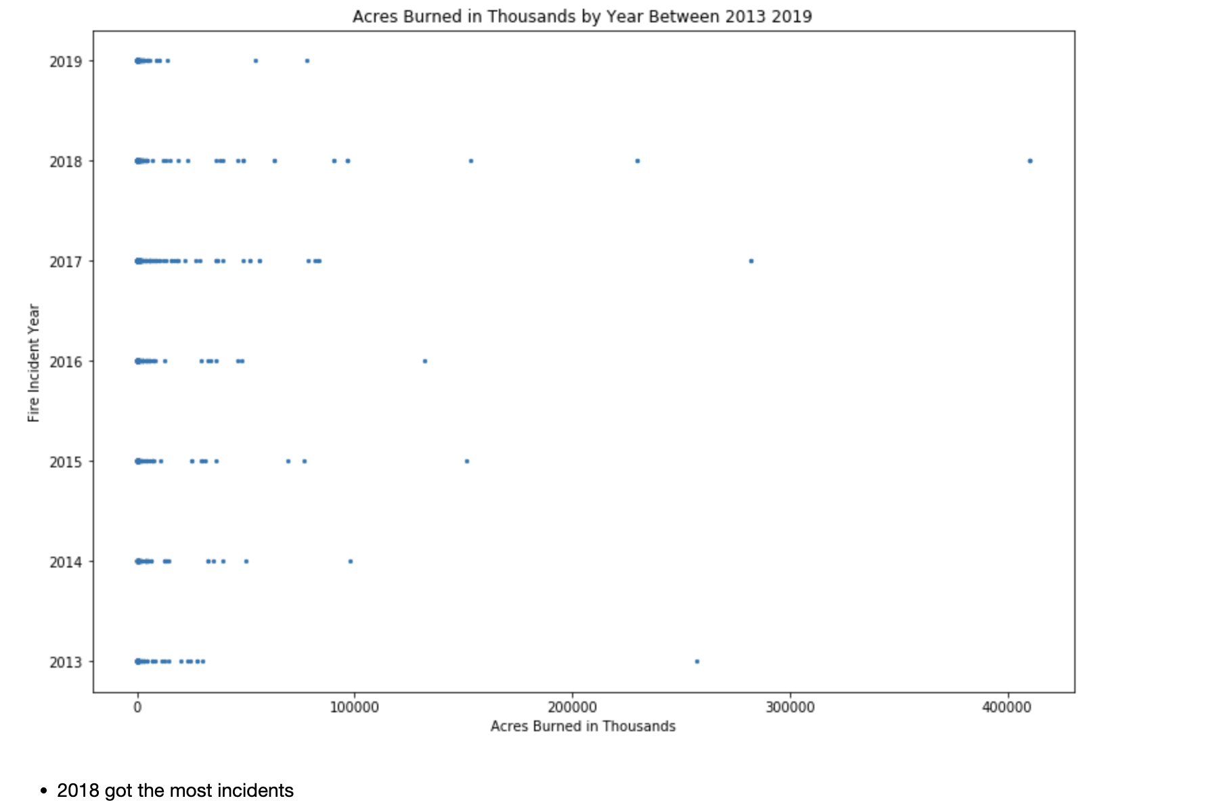
Data Visualization
2018 fires burned more acreage even though the no incidents was less.

Slide 9
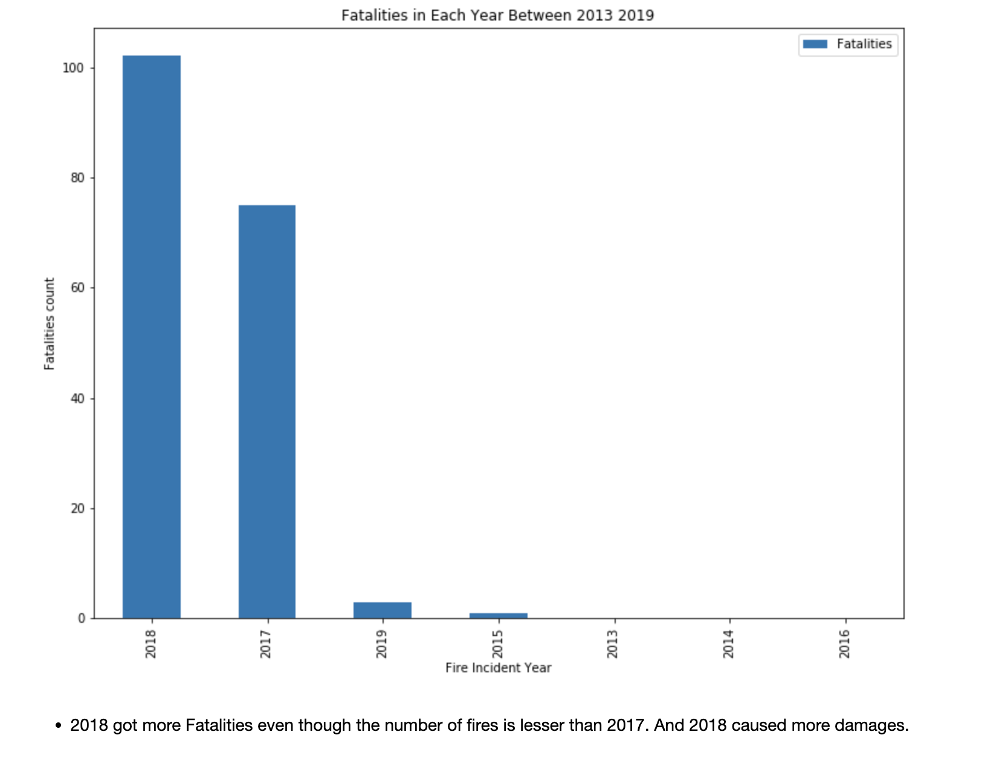
Data Visualization
2018 received more fatalities.

Slide 10
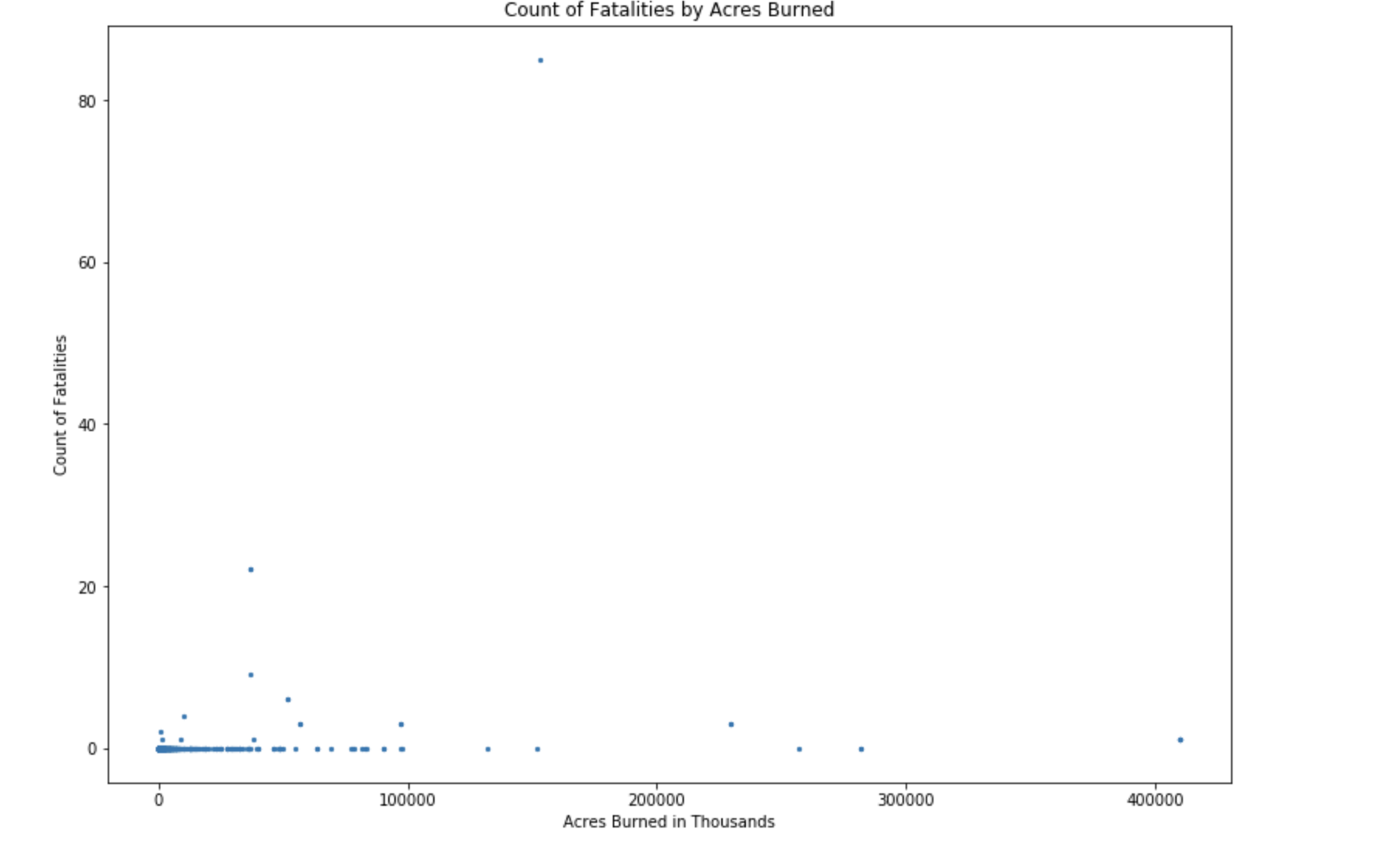
Data Visualization
Fatality count is not directly correlating to the acreage due to less populated area is mostly burned in wildfire.

Slide 11
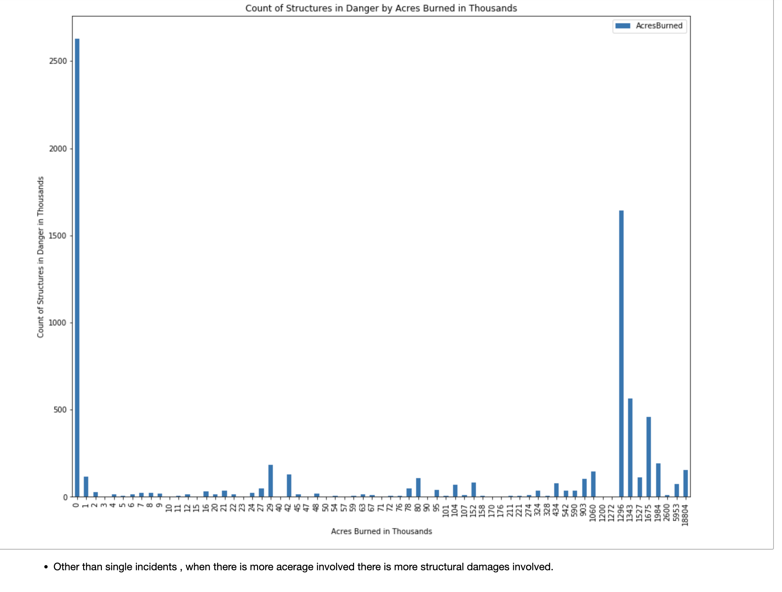
Data Visualization
Single incidents creates more fatalities and structural damages in count . But destruction is more in wildfire.

Slide 12
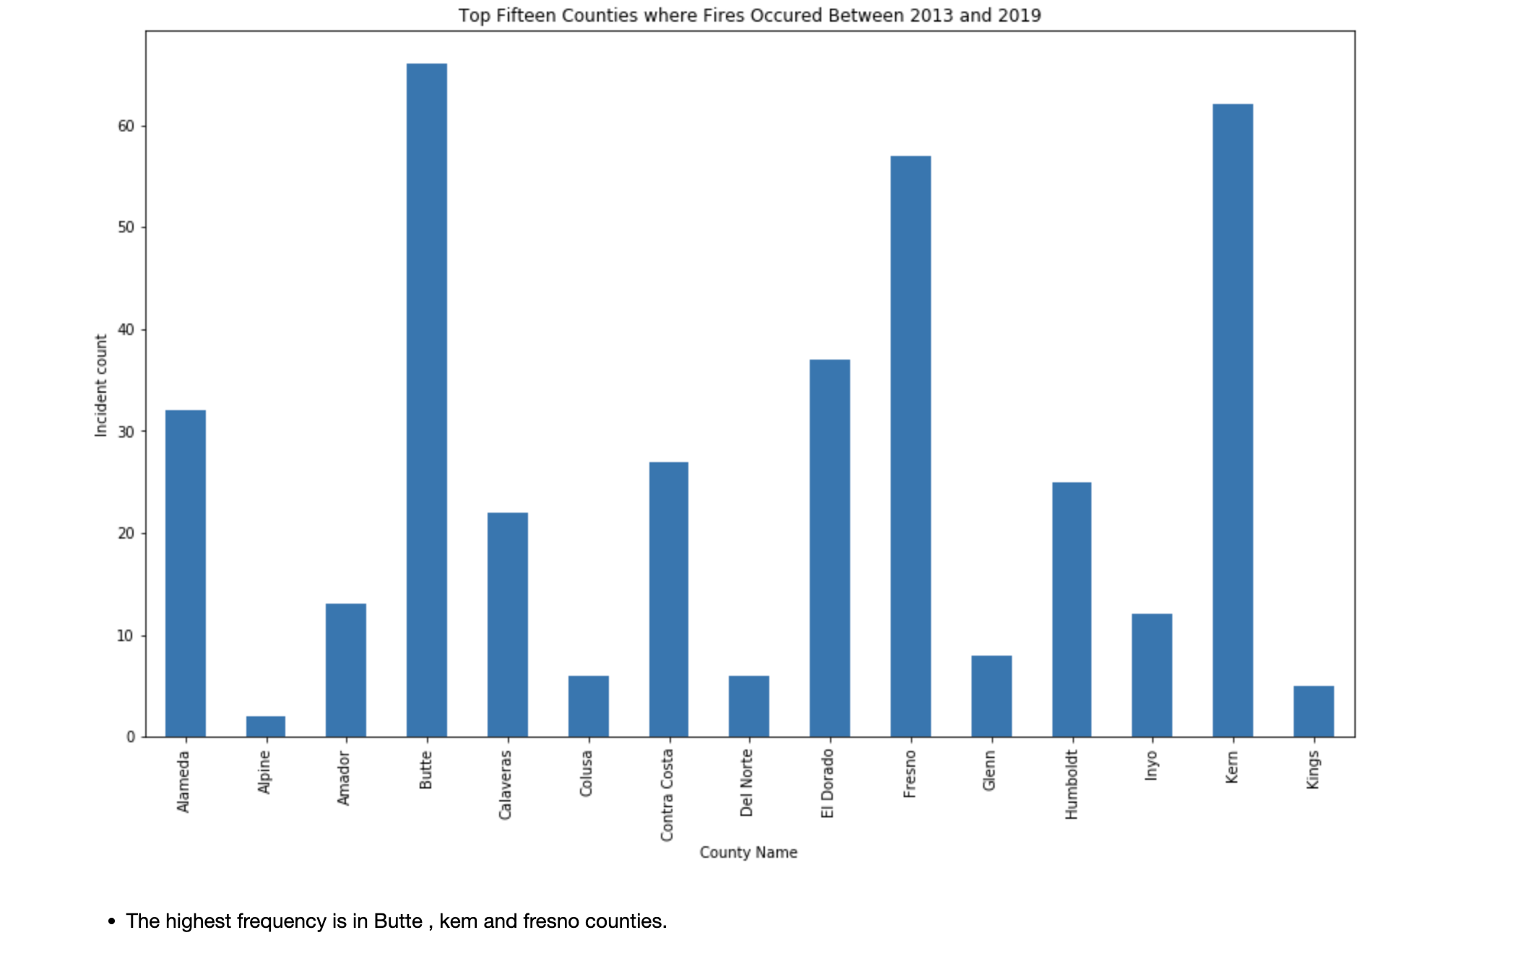
Data Visualization
Butte, Kem and Fresno is impacted heavily due to wildfire.

Slide 13
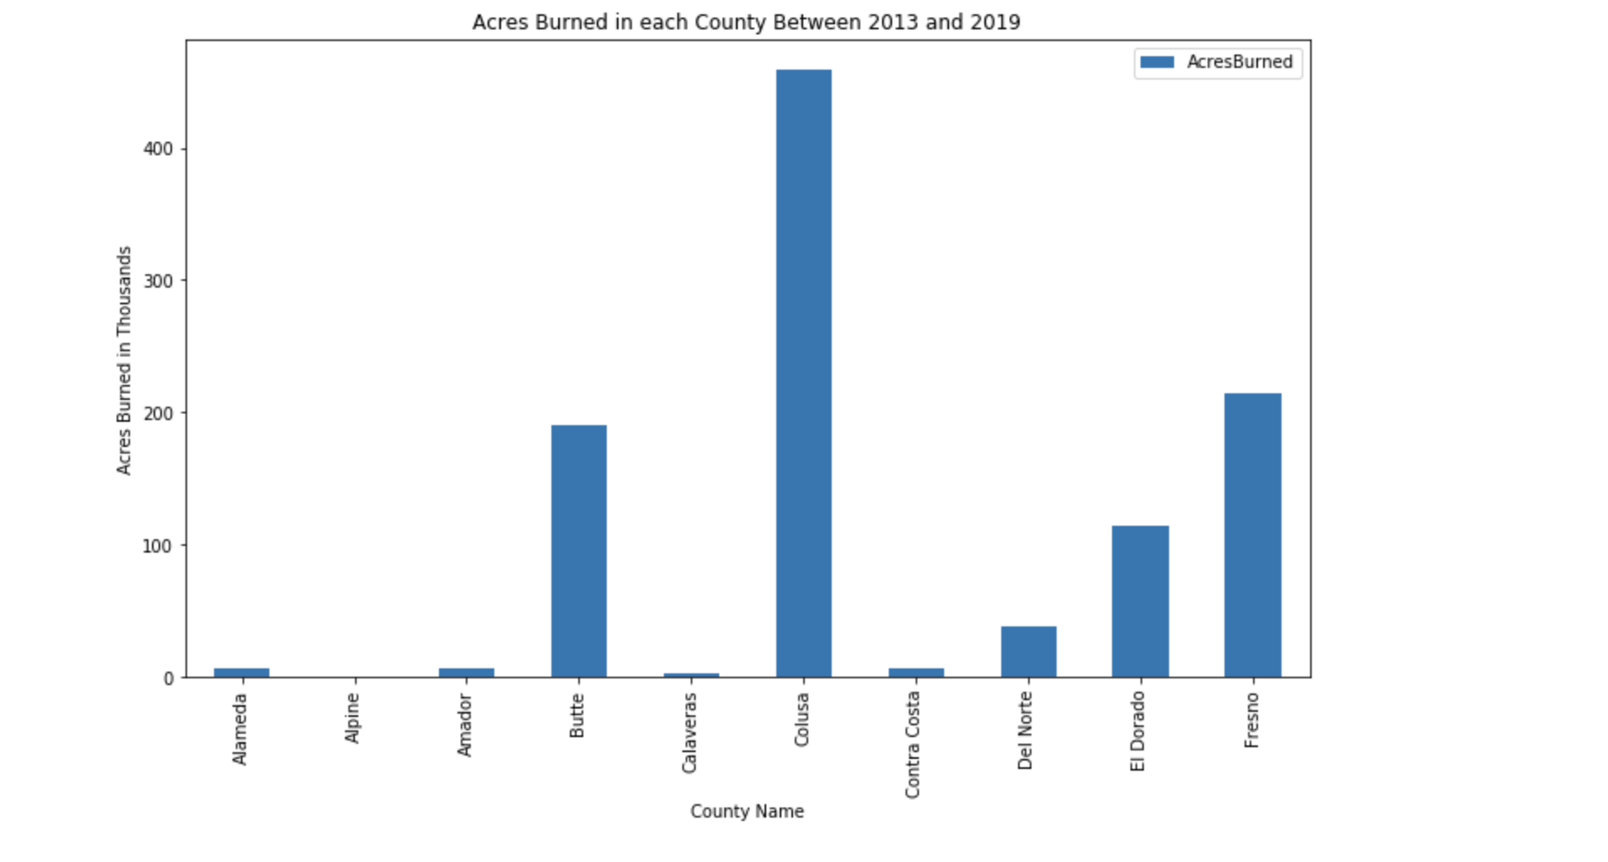
Data Visualization
Colusa is number one in wildfire count.

Slide 14
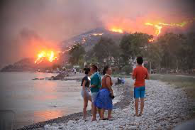
Machine learning idea
From total weather data California weather data is separated.

Slide 15
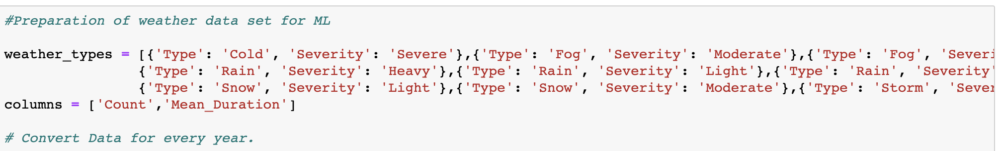
Data preparation
Major criteria used.
Type of weather.
Year.
Severity of weather.

Slide 16
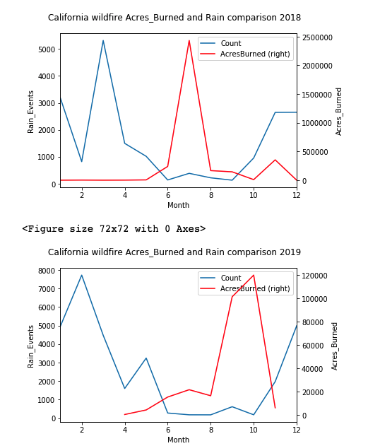
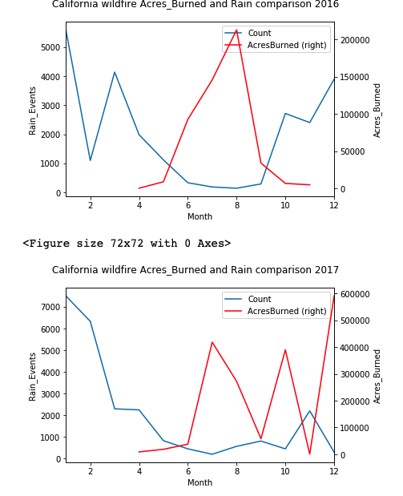
Data Visualization
Comparison on 2016,2017,2018 and 2019

Slide 17
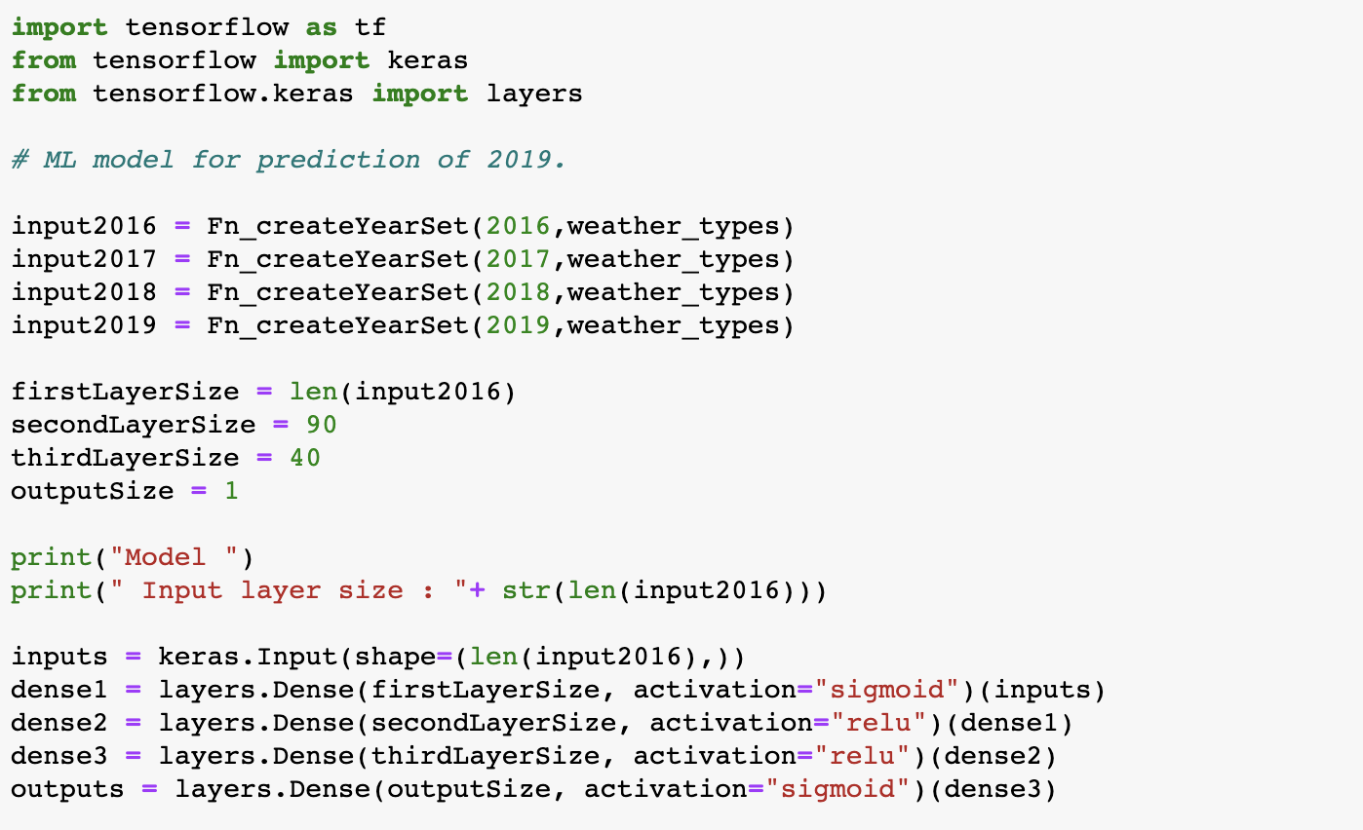
ML Used – Deep learning
Weather types.

Slide 18
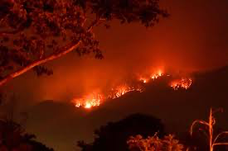
Conclusion
With a small data set it is very difficult to predict the wildfire.
There are more adverse conditions is in place every year.
This study can be explanted with larger dataset.
Received an accuracy of 86% from the test data

